Slide 1







INTERNET OF THINGS
SMART CITY
Opportunities, Challenges, and Future Directions
Presented by Group 3
Ngô Vi Việt Anh
Nghiêm Phan Thanh Tuấn
Trịnh Thị Mai Hương
Đỗ Minh Hiếu

Slide 2
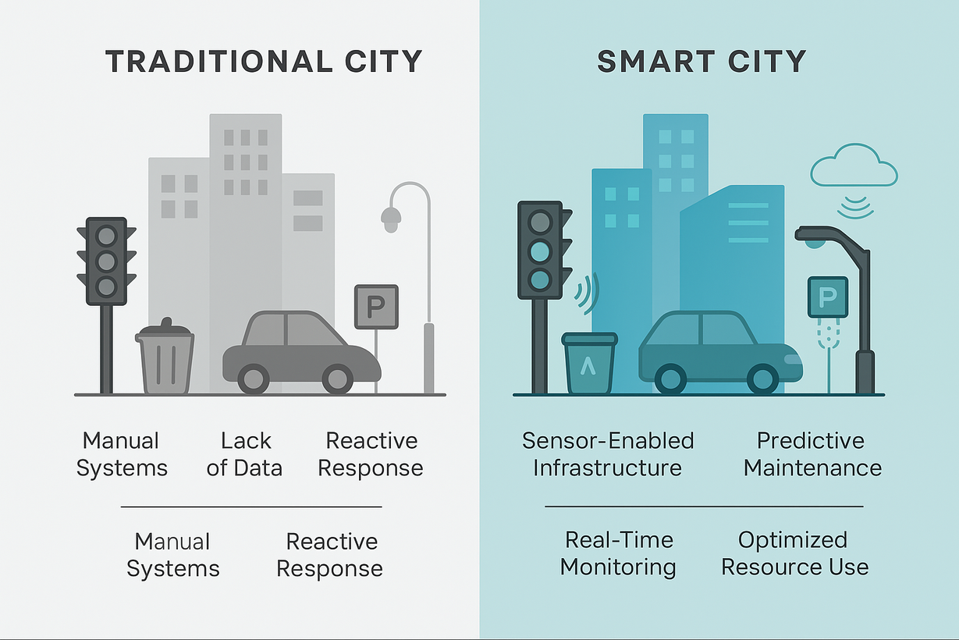
What is a Smart City? Why IoT?
A smart city utilizes digital technologies and data to enhance efficiency, sustainability, and the quality of life.
Role of IoT: Enables real-time sensing, communication, and automation across urban systems.
Presented by Group 3
1

Slide 3
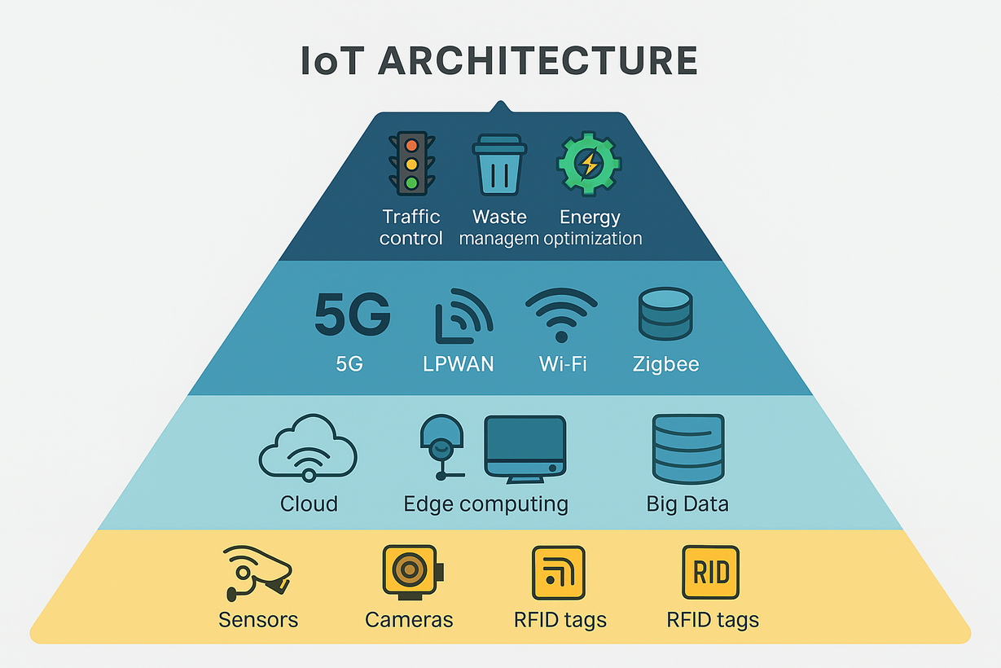
How Does It Work?
Perception Layer: Sensors, cameras, RFID tags
Network Layer: 5G, LPWAN, Wi-Fi, Zigbee
Data Layer: Cloud, Edge computing, Big Data
Network Application Layer: Traffic control, waste management, energy optimization: 5G, LPWAN, Wi-Fi, Zigbee
Presented by Group 3
2

Slide 4


SMART CITIES
around the world
3

Slide 5
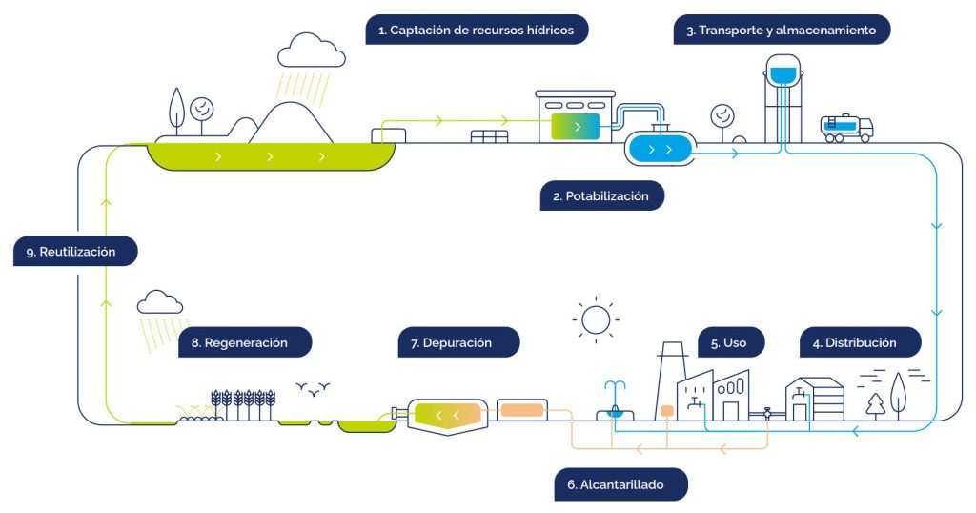
Barcelona's Smart Water Management
IoT Sensors: Track flow, pressure, and soil moisture in real time
Connectivity: Data transmitted via LoRaWAN or Wi-Fi
Cloud & AI: Analyze patterns, detect leaks, optimize usage
Remote Control: City operators manage systems from dashboards
Impact:
25% reduction in water consumption
Faster leak detection and response
Presented by Group 3
4

Slide 6
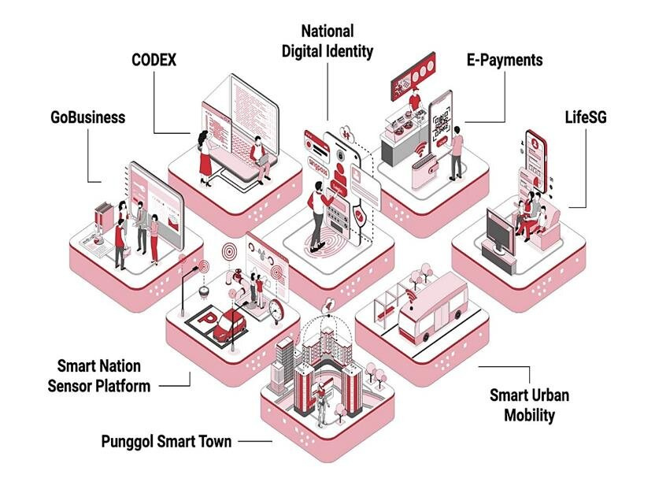
Singapore – Smart Nation Sensor Platform (SNSP)
Nationwide IoT Infrastructure: Unifies data from streetlights, lampposts, CCTV, environment sensors
Interconnected Systems: Supports predictive maintenance, crowd monitoring, and urban planning
Integrated with AI & Cloud: Enables real-time alerts and insights
Impact:
Improved emergency response
Efficient public services
Enhanced public safety
Presented by Group 3
5

Slide 7



SMART CITIES in VIETNAM
6

Slide 8
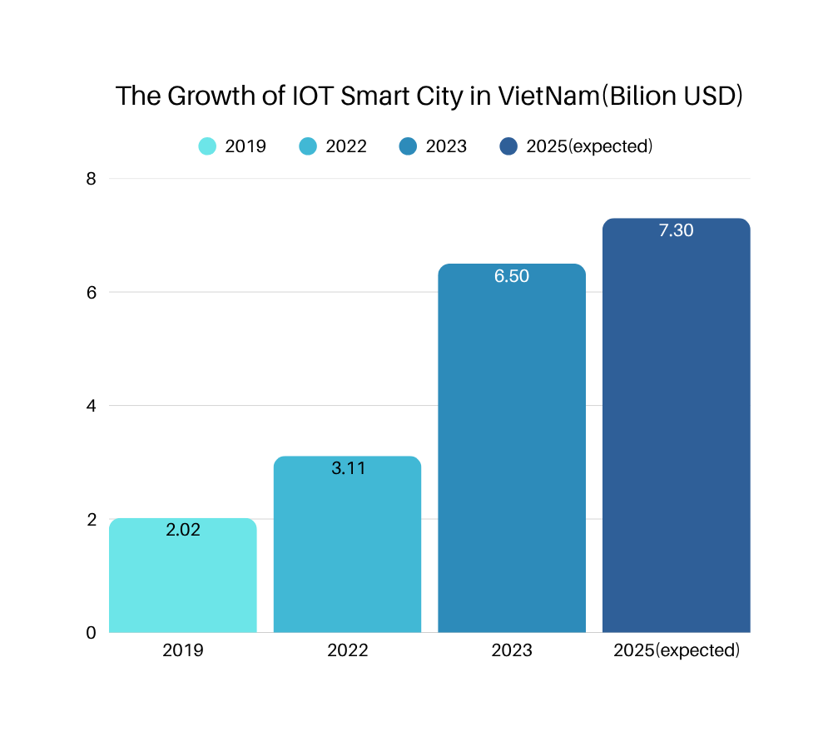
IoT and Smart City Market in Vietnam
2019: IoT market valued at ~$2.02 billion
2022: Grew to ~$3.11 billion (Source: Markets & Data)
2023: Smart City sector worth ~$6.5 billion, with projected 36.7% CAGR to 2030
2025 (Forecast):
IoT market expected to reach ~$7.3 billion
Estimated ~96 million active IoT devices
Presented by Group 3
7

Slide 9




IoT Applications in Smart Cities – Vietnam Overview
Smart Traffic ITS
Environmental IoT
CCTV, video analytics, intelligent traffic signals
Air/water monitoring sensors, IoT environmental platforms
Parking IoT
Smart Energy
GPS, location sensors, mobile payment apps
Smart meters, SaaS-based cloud energy management
Presented by Group 3
8

Slide 10




Opportunities for Vietnam
Vietnam’s rapid urbanization, 5G rollout, and green tech focus create ideal conditions for IoT-driven smart city growth
Urbanization = Strong Demand for Smart Solutions
5G Infrastructure and IoT Startups Growing
Green Tech + AI + IoT = Sustainable Development
Presented by Group 3
9

Slide 11



Data Privacy & Cybersecurity Risks
Challenges for Vietnam
IoT expansion increases cyber threats; Vietnam lacks strong regulations and safeguards.
High Costs, Unclear ROI
Smart systems need big investment, but private firms hesitate without clear returns.
Tech Talent Shortage
Skilled workers in AI, embedded systems, and cybersecurity are still limited.
Regulatory Gaps
Policies on data, integration, and public-private cooperation remain underdeveloped.
Presented by Group 3
10

Slide 12
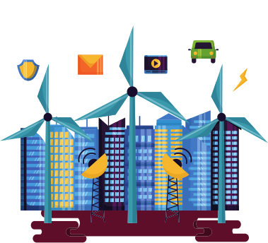





Global IoT Future Outlook (2030 Vision)
2024
2025
203-
SPENDING
~900 bilion USD
~1200 bilion USD
>1500 bilion USD
Devices
18.8 bilion
27 bilion
40 bilion
Global Revenue
5,5 – 12,6 thousand bilion USD
Presented by Group 3
11

Slide 13






EMERGING FOCUS AREAS
With the synergy of AI and edge computing, emerging focus areas will shift towards real-time decision-making, ultra-low latency applications, and decentralized intelligence across smart systems.
Urban infrastructure optimization
Real-time Traffic Monitoring & Control
Environmental Sensing & Sustainability
Public Safety & Predictive Maintenance
Smart sensors to manage utilities efficiently.
AI-powered systems reduce congestion.
Air, noise, and pollution tracking for better planning.
Early alerts for accidents & proactive repairs.
Presented by Group 3
12

Slide 14

THANK YOU

